Slide 1
Introduction to Image Processing using OpenCV-Python
Compiled by: Nanik Suciati

Slide 2
OpenCV in Python?
It stands for ‘Open Source Computer Vision Library’ initiated by some enthusiast coders in ‘1999’ to incorporate Image Processing into a wide variety of coding languages (C++, C, and Python) running on Windows, Linux, Android and Mac.
OpenCV-Python is the Python API of OpenCV. It combines the best qualities of OpenCV C++ API and Python language.
Python is a general purpose programming language started by Guido van Rossum, which became very popular in short time mainly because of its simplicity and code readability. It enables the programmer to express his ideas in fewer lines of code without reducing any readability.

Slide 3
OpenCV in Python?
Compared to other languages like C/C++, Python is slower. But Python can be easily extended with C/C++. This feature helps us to write computationally intensive codes in C/C++ and create a Python wrapper for it so that we can use these wrappers as Python modules. This gives us two advantages: ﬁrst, our code is as fast as original C/C++ code (since it is the actual C++ code working in background) and second, it is very easy to code in Python. This is how OpenCV-Python works, it is a Python wrapper around original C++ implementation.
And the support of Numpy makes the task more easier. Numpy is a highly optimized library for numerical operations. It gives a MATLAB-style syntax. All the OpenCV array structures are converted to-and-from Numpy arrays. So whatever operations you can do in Numpy, you can combine it with OpenCV. Besides that, several other libraries like SciPy, Matplotlib which supports Numpy can be used with this. So OpenCV-Python is an appropriate tool for fast prototyping of computer vision problems

Slide 4
Get started
To start:
Instalasi python and their packages:
http://www.southampton.ac.uk/~fangohr/blog/installation-of-python-spyder-numpy-sympy-scipy-pytest-matplotlib-via-anaconda.html
Instalasi Anaconda python in windows:
http://docs.continuum.io/anaconda/install/windows/

Slide 5
Get started
You can import the OpenCV-Python package by:
Open Anaconda prompt and type the following command:
conda install -c menpo opencv

Slide 6
Get started
Python Numpy Tutorial → http://cs231n.github.io/python-numpy-tutorial/
OpenCV-Python Tutorials Documentation, Release 1, Alexander Mordvintsev & Abid K, 2014 → ebook in freeshare
Learn how to read and show image (pp. 20)
Learn about core operation in image (pp. 33)
Learn how to threshold an image.
Code example: ImageProcessing v1.py

Slide 7
Example of Computer Vision Project → Face Recognition
Face image dataset
Preprocessing
Feature extraction
Feature Vectors
Training Data
Training process
Splitting
Testing Data
Classifier Model
Recognition
Recognition result

Slide 8
Dataset
We use Face94 dataset (available at cswww.essex.ac.uk).
The dataset consists of 3040 face images from 152 distinct person.
There are 20 images with different expression for each person, since those 20 sequence images are captured when a person is speaking in front of camera. Size of each image is 200 x 180 pixels.
The dataset is split as training and testing data with proportion 75 and 25 percentage, respectively. Using this proportion, 16 images of each person are used as training, and the rest (4 images) are used as testing data, so that the total number of training and testing images is 2280 and 760.

Slide 9
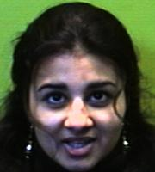
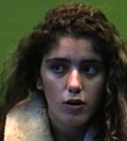
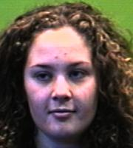
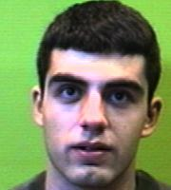
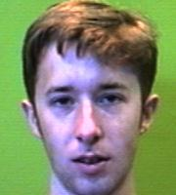
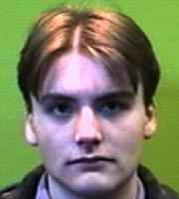
Dataset

Slide 10
Code in opencv python
Ekstraksi Fitur Wajah_Rata2Warna v1.py
Klasifikasi_KNN v1.py
Pelajari dan jalankan program di atas.

